Slide 1
Themodynamics fluid properties
- Course TESM
Cong Toan TRAN

Slide 2
Rappels
Variable | Symbol | Unit
Temperature | T | K
Pressure | P | Pa
Volume | V | m3
Enthalpy | H | J
Entropy | S | J/K
Internal energy | U | J
Specific heat capacity | c_{p} | J/(K.kg)
Specific Enthalpy | h | J/kg
An intensive property does not depend on the system size or the amount of material in the system
Extensive properties are additive for subsystems

Slide 3
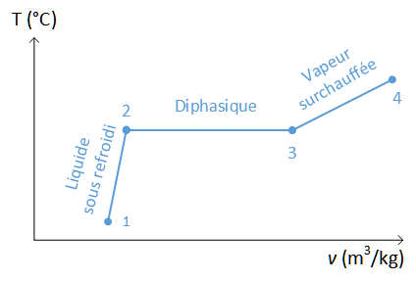
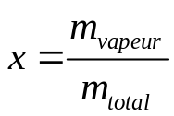
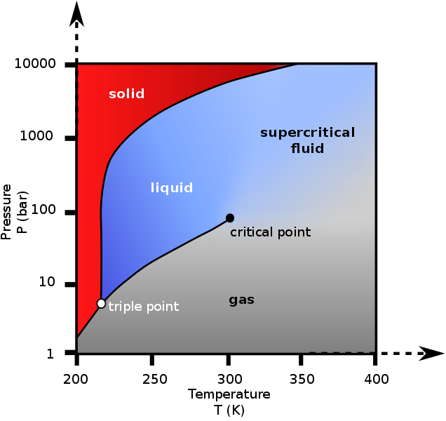

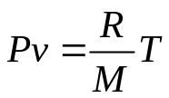
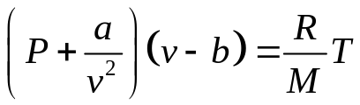
Properties of a pure fluid
2 common phases:
  Subcooling liquid
  Overheating liquid
    Diphasic
  (Supercritical phase)
In a saturated mixture, vapor quality is:
For a given intensive variable z (such as specific enthalpy)
State equation = relation between state variables
  Perfect gas:
  Real gas:

Slide 4
Degree of freedom
The number of degrees of freedom (F) is the number of intensive variables which are independent of each other.
Gibbs phase rule:
  F degree of freedom
  N number of components
  Φ number of phases
F = N – Φ + 2

Slide 5
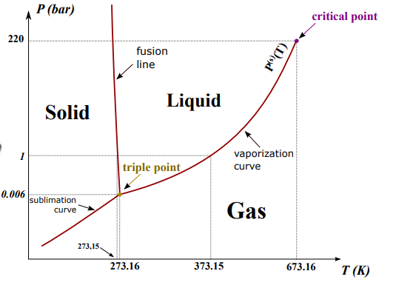
Degree of freedom
Example:
  Single component / single phase : F = 2
  Single component / two phase : F = 1
  Single component / three phase : F = 0
  Binary system / single phase: F = 3

Slide 6
How to calculate a thermodynamic property
Calculate the degree of freedom
Identify the appropriate state variables which are known
Use one of the two following options:
  Property diagrams (P-T diagram, P-v diagram …)
  Programs which calculate the property

Slide 7
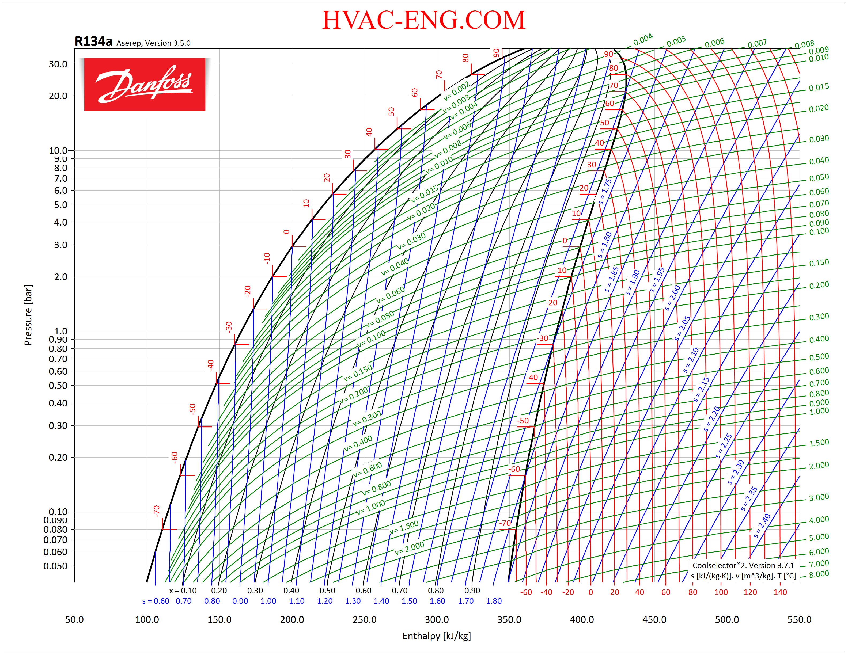
Example of p-h diagram

Slide 8
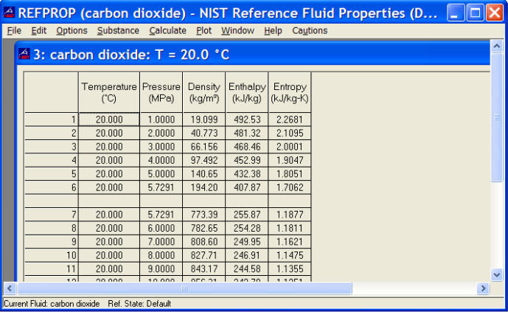
Example of Refprop
Estimate the cost of gas to heat the water used during a shower !

Slide 9
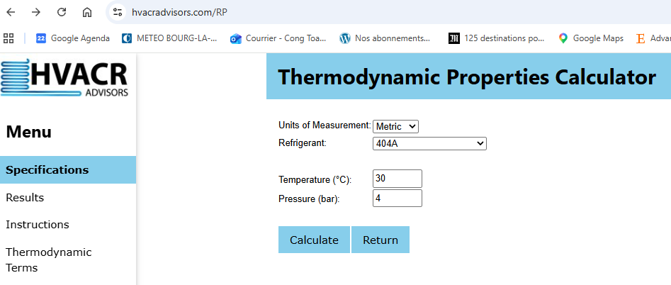
Example of a free tool on Internet

Slide 10
Example of CoolProp in Python
Directly from CoolProp:
from CoolProp.CoolProp import PropsSI
p = 1e5
T= 10+273,15
h = PropsSI("H", "P", p, ‘’T", T, ‘air’)
Or from Caldis (only availlable for certain functions):
from caldis.fluids.coolprop_backend import CoolPropBackend
be_air = CoolPropBackend("Air")
p = 1e5
T= 10+273,15
be_air.h_pt(p, T)

Slide 11
Thank you !

